Slide 1
From Concept to Reality: A Guide to Logo Development

Slide 2
Designing a Symbol for Modern Brands
With more and more companies and products competing for market recognition online and offline, a well-designed logo is a business advantage that captures the attention of consumers and represents the core values of a brand at a glance.

Slide 3
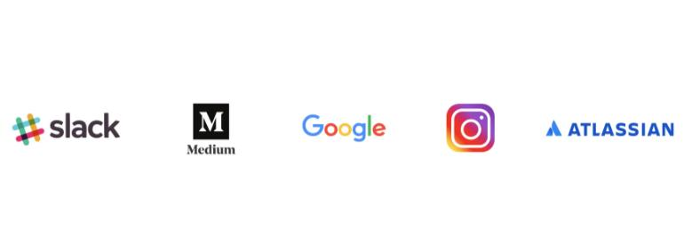
Designing a Symbol for Modern Brands
A good logo is more than a generic icon; it’s an embodiment of what a company stands for—a visual ambassador for a brand.

Slide 4
Characteristics of a Successful Logo： the five principles of the S.M.A.R.T. system
Simple: Make it easy to understand and identify.
Memorable: A good logo should be distinctive enough to be memorable.
Ageless: The best logos are timeless and survive changing trends.
Reliable: Flexibility and scalability are key to using a logo across different platforms, mediums, and sizes.
Thoughtful: Every detail of a logo should be considered and honed to effectively symbolize the quality and usefulness of a brand.

Slide 5
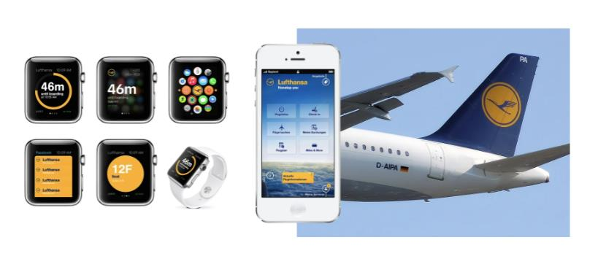
Characteristics of a Successful Logo： the five principles of the S.M.A.R.T. system
For modern brands, logos should be designed with many use cases in mind. For example, a logo for an airline needs to work as a tiny icon on a mobile app while still looking good at very large scale on a plane’s tail.

Slide 6
Keys to Understanding the Design Brief
The first phase of the logo design process involves reviewing and understanding the design brief. This is a relatively simple task, but it’s crucial. Think of it as the foundation of a house. A shabby understanding of the brief will create a host of problems throughout the project.

Slide 7
What is a design brief?
Goals: Does the project have specific goals it must meet in order to be considered a success?
Deliverables: What are the deliverables that will be expected at the project’s completion?
Timeline: Are there expectations that the project should be completed within a certain amount of time?
Project Stakeholders: Who is involved in the project’s decision making?
Target Audience: What segment of the population should the logo resonate with?

Slide 8
What is a design brief?
Product or Company Profile: What purpose does the product or company serve? What value do they bring people?
Brand Positioning Statement: What is the core of the brand’s promise to consumers, and how does it see itself in relation to its competitors?
Budget and Payment: Is there a project budget, and how will payments be handled?

Slide 9
Visual Research and Art Direction
Visual Research – Uncovering Inspiration
Visual research is a time for the designer to open their eyes and see the world. It involves browsing through art and design related books, portfolio sites, and magazines. It also includes trips to museums, galleries, retail stores, or inspiring landmarks.

Slide 10
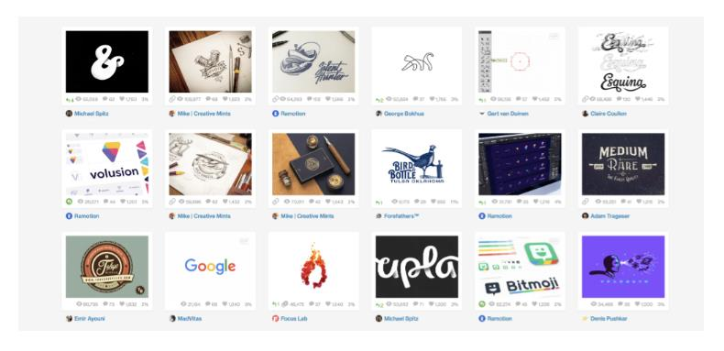
Visual Research and Art Direction
The main point is revving the imagination by inundating yourself with high-quality examples of beauty, ingenuity, and craftsmanship.

Slide 11
Visual Research and Art Direction
Here’s a brief list of online resources to help start your search:
LogoLounge is a logo-centric showcase site for browsing logos from designers around the world.
Dribbble is a highly influential design platform where designers religiously upload their latest and greatest work.
Muzli is a website that aggregates the most popular design work from across the web.

Slide 12
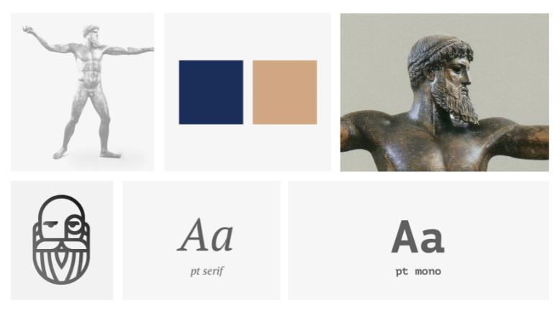
Art Direction – Paving a Clear Path of Creative Intent
Once visual research is complete, designers should lead clients through at least one round of art direction. This is a time to distill visual research into a concise plan of artistic intent through the use of a moodboard—a mosaic of themes, feelings, and visual ideas.

Slide 13
Ideation and Sketching
Ideation – Where Do Ideas Come from?
Eventually, research must turn into creative output as ideas travel from the mind to the page.

Slide 14
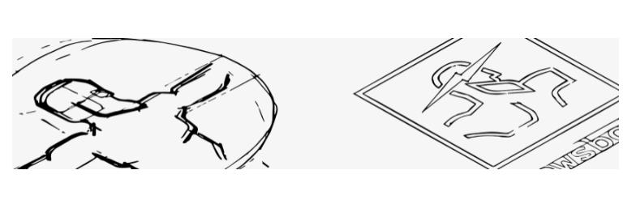
Ideation and Sketching
A great way to kickstart this part of the logo design process, called ideation, is a brainstorming session—a time of capturing relevant concepts and narrowing in on the most viable options.

Slide 15

Ideation and Sketching
Sketching – A Valuable Practice for Every Logo Designer
Fast, crude sketching is a great way to explore ideas quickly and without regard to a “finished” quality.

Slide 16
Digital Refinement
After working through ideation and concept sketching, you’ll be equipped with a dependable blueprint for refining the logo in Adobe Illustrator.

Slide 17
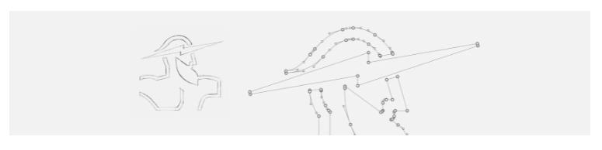
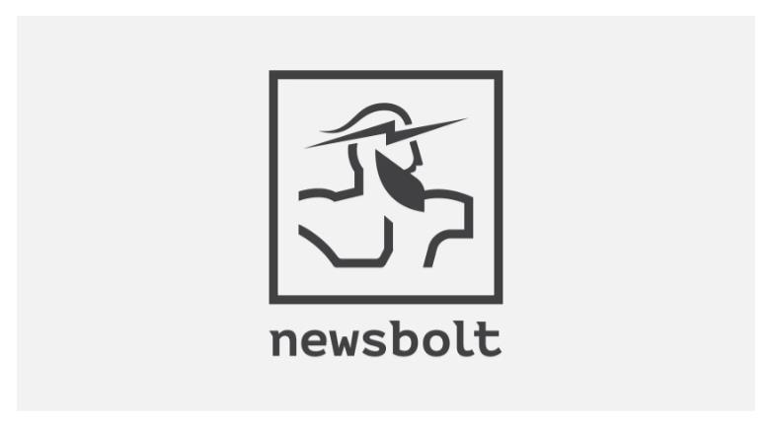
Digital Refinement

Slide 18
Illustrator’s most useful logo design tools:
Basic Shapes: Learn to use the geometry of circles, rectangles, triangles, and squares to create more complex shapes and designs.
Align Tool: Save time and prevent headaches by understanding how to efficiently align objects with precision.
Pathfinder: Use intersecting shapes to create new shapes and symbols quickly.
Shape Builder: The Pathfinder has its limits. Luckily, the Shape Builder is more than ready to pick up the slack.
Pen Tool: It can be a tricky tool to learn, but be bold.

Slide 19
Color in Logo Design
The use of color in logo design is a vast and highly important topic that covers a diverse array of disciplines ranging from color theory to human psychology. With that in mind, it’s best to present clients with simple, yet harmonious, color schemes that provide high contrast.

Slide 20
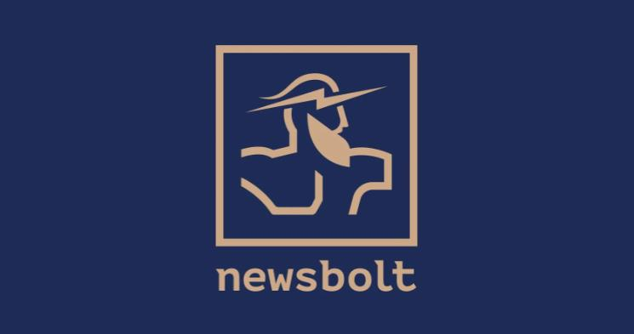
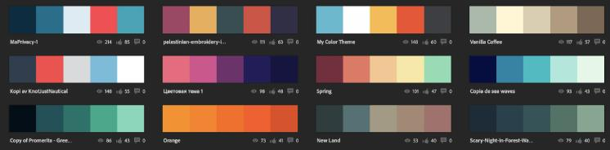
Color in Logo Design

Slide 21
Online resources to aid designers in their knowledge of color:
Ctrl+Paint: Concept artist Matt Kohr presents a series of quick and simple video tutorials that explain color selection and mixing from a digital painting perspective.
COLOURlovers: A creative community where artists and designers from around the world create and share color schemes.
Adobe Color CC: Color CC allows users to create color schemes with a sophisticated color wheel or browse thousands of color combinations from the Adobe community.
Pinterest: Pinterest is packed with ready-made color schemes, and it’s a great place to observe color trends as they evolve over the course of a year.

Slide 22
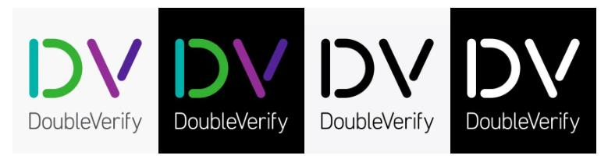
Color in Logo Design
When creating color schemes, it’s important to remember that logos must eventually leave the cozy confines of Illustrator and Sketch, where white space runs on forever, to live and work in the real world.

Slide 23
Color in Logo Design
This requires that a logo work on light and dark backgrounds as well as in black and white. As you preview a logo in these settings, be prepared to make minor adjustments.

Slide 24
Organize and Deliver Files：Formatting
Print Files: Vector format files are preferred for print because they allow a logo to remain sharp and clear at large scales and low resolutions. Formats include EPS, SVG, AI, and PDF.
Web Files: The web requires either pixel-based files (JPEG, PNG, GIF) or vector-based files (SVG – Scalable Vector Graphics).
JPEG files are best if the logo design uses several color transitions and gradients because they keep a richer photographic render of the original design.
PNG images are best when the logo design utilizes mostly flat colors and shapes, with little to no shadow or gradient action.

Slide 25
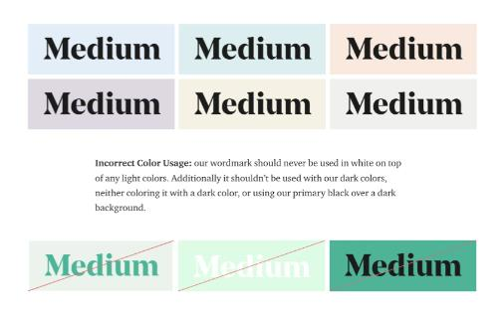
How to Equip Clients with Value and Vision
Offer a Basic Style Guide
Creating a nice logo is admirable, but designer should also consider how to equip clients with a simple strategy for using a logo effectively.

